Slide 1
Lecture 7: Caffe: GPU Optimization
boris. ginzburg@intel.com

Slide 2
Agenda
Practical intro to CUDA
Programming model
Memory model
Exercises
Caffe: CUDA part
SynchedMemory
Forward_gpu( );
Projects

Slide 3
CUDA: prActical introduction
Based on David Kirk and Wen-mei W. Hwu tutorial
(2007, Univ. of Illinois, Urbana-Champaign )

Slide 4
Example1 : VecAdd
Based on NVIDIA_SAMPLES/SIMPLE/.vecAdd.cu
// Kernel definition
__global__ void VecAdd(float* A, float* B, float* C) {
int i = threadIdx.x;
C[i] = A[i] + B[i];
}
int main() {
...
// Kernel invocation with N threads
int numBlocks = 1;
int threadsPerBlock = N;
VecAdd<<< numBlocks, threadsPerBlock >>>(A, B, C);
...
}

Slide 5
Programming Model: Grid/Block/Thread
A kernel is executed as a grid of thread blocks
All threads share global memory
A thread block is a batch of threads that can cooperate with each other by:
Synchronizing their execution
Efficiently sharing data through a low latency shared memory
Two threads from two different blocks cannot cooperate
Host
Device
Grid 1
Kernel 1
Block
(0, 0)
Block
(1, 0)
Block
(2, 0)
Block
(0, 1)
Block
(1, 1)
Block
(2, 1)
Grid 2
Kernel 2
Block (1, 1)
Thread
(0, 0)
Thread
(1, 0)
Thread
(2, 0)
Thread
(3, 0)
Thread
(4, 0)
Thread
(0, 1)
Thread
(1, 1)
Thread
(2, 1)
Thread
(3, 1)
Thread
(4, 1)
Thread
(0, 2)
Thread
(1, 2)
Thread
(2, 2)
Thread
(3, 2)
Thread
(4, 2)
Courtesy: D. Kirk and W.W. Hwu

Slide 6
Programming Model: Block and Thread IDs
Threads and blocks have IDs
So each thread can decide what data to work on
Block ID: 1D or 2D
Thread ID: 1D, 2D, or 3D
Max # of theads/block=1024
Device
Grid 1
Block
(0, 0)
Block
(1, 0)
Block
(2, 0)
Block
(0, 1)
Block
(1, 1)
Block
(2, 1)
Block (1, 1)
Thread
(0, 0)
Thread
(1, 0)
Thread
(2, 0)
Thread
(3, 0)
Thread
(4, 0)
Thread
(0, 1)
Thread
(1, 1)
Thread
(2, 1)
Thread
(3, 1)
Thread
(4, 1)
Thread
(0, 2)
Thread
(1, 2)
Thread
(2, 2)
Thread
(3, 2)
Thread
(4, 2)
Courtesy: D. Kirk and W.W. Hwu

Slide 7
Calling a Kernel Function – Thread Creation
A kernel function is called with an execution configuration:
__global__ void KernelFunc(...);
dim3 DimGrid(100, 50); // 5000 thread blocks
dim3 DimBlock(4, 8, 8); // 256 threads per block
KernelFunc<<<DimGrid,DimBlock>>>(...);

Slide 8
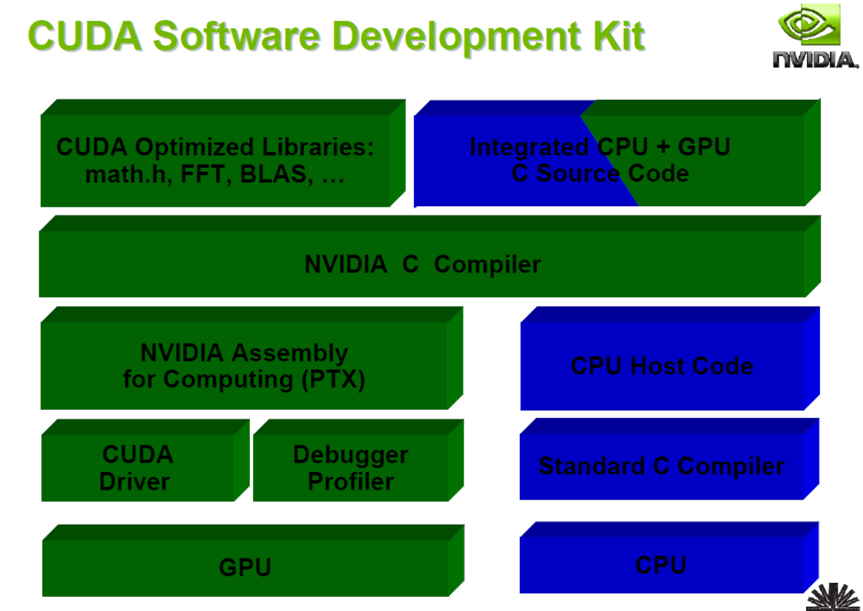
CUDA SDK

Slide 9
CUDA Makefile Example
GCC := g++
NVCC := nvcc -ccbin $(GCC)
CCFLAGS := -g
NVCCFLAGS := -m64 -g -G
LDFLAGS :=
ALL_CCFLAGS := $(NVCCFLAGS) $(addprefix -Xcompiler ,$(CCFLAGS))
ALL_LDFLAGS := $(ALL_CCFLAGS) $(addprefix -Xlinker ,$(LDFLAGS))
# Common includes and paths for CUDA
INCLUDES := -I../common/inc
LIBRARIES :=
# CUDA code generation flags
GENCODE_SM30 := -gencode arch=compute_30,code=sm_30
GENCODE_SM50 := -gencode arch=compute_50,code=sm_50
GENCODE_FLAGS := $(GENCODE_SM30) $(GENCODE_SM50)

Slide 10
CUDA Makefile Example – cont.
# Target rules
all: vectorAdd
vectorAdd.o:vectorAdd.cu
$(NVCC) $(INCLUDES) $(ALL_CCFLAGS) $(GENCODE_FLAGS) -o $@ -c $<
vectorAdd: vectorAdd.o
$(NVCC) $(ALL_LDFLAGS) $(GENCODE_FLAGS) -o $@ $+ $(LIBRARIES)
run: all
./vectorAdd
clean:
rm -f vectorAdd vectorAdd.o

Slide 11
Example 2: Matrix Add
// Kernel definition
__global__ void MatAdd(floatA[N][N], floatB[N][N], float C[N][N]) {
int i = threadIdx.x;
int j = threadIdx.y;
C[i][j] = A[i][j] + B[i][j];
}
int main() {
…
// Kernel invocation with one block of N * N * 1 threads
int numBlocks = 1;
dim3 threadsPerBlock(N, N);
MatAdd<<<numBlocks, threadsPerBlock>>>(A, B, C);
...
}

Slide 12
Example 2: Matrix Add with Blocks
// Kernel definition
__global__ void MatAdd(floatA[N][N], floatB[N][N], floatC[N][N]) {
int i = blockIdx.x * blockDim.x + threadIdx.x;
int j = blockIdx.y * blockDim.y + threadIdx.y;
if(i < N && j < N) C[i][j] = A[i][j] + B[i][j];
}
int main() {
...
// Kernel invocation
dim3 threadsPerBlock(16, 16);
dim3 numBlocks( N / threadsPerBlock.x, N / threadsPerBlock.y);
MatAdd<<<numBlocks, threadsPerBlock>>>(A, B, C);
...
}

Slide 13
Example 3: Matrix Multiply
N
WIDTH
M
P
ty
WIDTH
tx
WIDTH
WIDTH

Slide 14
Example 3: Matrix Multiply
N
Block of threads compute matrix P:
Each thread computes one element of P:
Loads a row of matrix M
Loads a column of matrix N
Perform one multiply-add for each pair of M and N elements
Size of matrix limited by max # of threads per thread block: 1024
Grid 1
Block 1
Thread
(2, 2)
48
BLOCK_SIZE
M
P

Slide 15
Example 3: Matrix Multiply – cont.
// Matrix multiplication kernel – thread specification
__global__ void MatrixMulKernel(Matrix M, Matrix N, Matrix P) {
// 2D Thread ID
int tx = threadIdx.x;
int ty = threadIdx.y;
float z = 0; // accumulator for P
for (int k = 0; k < W; ++k) {
z += M [ ty * W + k ] * N[ k * W + tx ];
}
// Write z to device memory;
P [ ty * W + tx ] = z;
}

Slide 16
Memory model
Each thread can:
R/W per-thread registers
R/W per-thread local memory
R/W per-block shared memory
R/W per-grid global memory
Read only per-grid constant memory
Read only per-grid texture memory
(Device) Grid
Block (0, 0)
Block (1, 0)
Shared Memory
Shared Memory
Registers
Registers
Registers
Registers
Thread (0, 0)
Thread (1, 0)
Thread (0, 0)
Thread (1, 0)
The host can R/W global, constant and texture memory
Local
Memory
Local
Memory
Local
Memory
Local
Memory
Host
Global
Memory
Constant
Memory
Texture
Memory
Notes:
Global, constant, and texture memory spaces are persistent across kernels called by the same application.

Slide 17
CUDA Shared Memory
Threads inside Thread Block can share some block of local memory.
Access to Shared Memory is much faster than to global memory.
The max amount of Shared Memory = 48K

Slide 18
Example 4: Matrix Multiply with Shared Memory
Thread block computes one square sub-matrix C_{sub} (BxB)
each thread computes one element of C_{sub}.
For this rectangular bands (WxB) are divided into sub-blocks (BxB).
Each sub-block is copied from Global memory into Shared Memory.
Each Thread [x,y] computes partial product, and adds it to C[x,y].
This saves a lot of READs from global memory

Slide 19
Example 4: Matrix Multiply with Shared Memory
__global__ void matrixMulCUDA(float *C, float *A, float *B, int wA, int wB) {
__shared__ float As[BLOCK_SIZE][BLOCK_SIZE]; // shared memory array As
__shared__ float Bs[BLOCK_SIZE][BLOCK_SIZE]; // shared memory array Bs
int bx = blockIdx.x; // Block index
int by = blockIdx.y;
int tx = threadIdx.x; // Thread index
int ty = threadIdx.y;
int aBegin = wA * BLOCK_SIZE * by; // first index of A
int aEnd = aBegin + wA - 1; // last ndex of A
int aStep = BLOCK_SIZE; // step to iterate through A
int bBegin = BLOCK_SIZE * bx; // first index of B
int bStep = BLOCK_SIZE * wB; // step to iterate through B

Slide 20
Example 4: Matrix Multiply with Shared Memory –cont.
float Csub = 0; // Csub to store the element of the result
// Loop over all the sub-matrices of A and B
for (int a = aBegin, b = bBegin; a <= aEnd; a += aStep, b += bStep) {
// Load the sub-matrices from device memory to shared memory;
As[ty][tx] = A[a + wA * ty + tx];
Bs[ty][tx] = B[b + wB * ty + tx];
__syncthreads(); // Synchronize to make sure the matrices are loaded
// Multiply the two sub-matrices together;
for (int k = 0; k < BLOCK_SIZE; ++k)
Csub += As[ty][k] * Bs[k][tx];
__syncthreads(); // Synchronize to make sure that computation is done
}
// Write the result to device memory;
int c = wB * BLOCK_SIZE * by + BLOCK_SIZE * bx;
C[c + wB * ty + tx] = Csub;
}

Slide 21
Example 4: Matrix Multiply with Shared Memory –cont.
float *d_A, *d_B, *d_C;
cudaMalloc((void **) &d_A, mem_size_A);
cudaMalloc((void **) &d_B, mem_size_B);
cudaMalloc((void **) &d_C, mem_size_C);
// Copy host memory to device
cudaMemcpy(d_A, h_A, mem_size_A, cudaMemcpyHostToDevice);
cudaMemcpy(d_B, h_B, mem_size_B, cudaMemcpyHostToDevice);
int block_size = 32;
dim3 threads(block_size, block_size);
dim3 grid(dimsB.x / threads.x, dimsA.y / threads.y);
matrixMulCUDA<32><<< grid, threads >>>(d_C, d_A, d_B, dimsA.x, dimsB.x);
cudaDeviceSynchronize();
// Copy result from device to host
cudaMemcpy(h_C, d_C, mem_size_C, cudaMemcpyDeviceToHost);
cudaFree(d_A);
…

Slide 22
CUDA 6.0 – Unified Memory+cublasXT
Unified CPU-GPU memory:
Before: Data that is shared between the CPU and GPU must be allocated in both memories, and explicitly copied between them by the programmer
Now: a pool of managed memory that is shared between the CPU and GPU, bridging the CPU-GPU divide. Managed memory is accessible to both the CPU and GPU using a single pointer. Data allocated in Unified Memory automatically migrates between host and device so that it looks like CPU memory to code running on the CPU, and like GPU memory to code running on the GPU.
cublasXT
new BLAS multi-GPU library that automatically scales performance across up to 8 GPUs /node; supporting workloads up to 512GB).
The re-designed FFT library scales up to 2 GPUs/node

Slide 23
Exercises
Implement 2D_correlation_CUDA
Implement ConvLayer_forward_CUDA

Slide 24
Caffe: GPU
GPU support in Caffe is based on:
SynchedMemory
“transparent” memory moving between CPU and GPU
GPU implementation for each layer
ConvolutionLayer::Forward_gpu( )
ConvolutionLayer::Backward_gpu( )

Slide 25
Caffe: SynchedMemory
class Blob {
public:
Blob()
….
protected:
shared_ptr<SyncedMemory> data_;
shared_ptr<SyncedMemory> diff_;
}

Slide 26
Caffe: SynchedMemory
class SyncedMemory {
public:
SyncedMemory() : cpu_ptr_(NULL), gpu_ptr_(NULL), size_(0), head_(UNINITIALIZED) {}
explicit SyncedMemory(size_t size) : cpu_ptr_(NULL), gpu_ptr_(NULL), size_(size), head_(UNINITIALIZED) { }
~SyncedMemory();
const void* cpu_data();
const void* gpu_data();
void* mutable_cpu_data();
void* mutable_gpu_data();
enum SyncedHead { UNINITIALIZED, HEAD_AT_CPU, HEAD_AT_GPU, SYNCED };
SyncedHead head() { return head_; }
size_t size() { return size_; }

Slide 27
Caffe: SynchedMemory
class SyncedMemory {
…
private:
void to_cpu();
void to_gpu();
void* cpu_ptr_;
void* gpu_ptr_;
size_t size_;
SyncedHead head_;
};

Slide 28
ConvolutionalLayer:: Forward_gpu()
void ConvolutionLayer<Dtype>::Forward_gpu(const vector<Blob<Dtype>*>& bottom, vector<Blob<Dtype>*>* top) {
const Dtype* bottom_data = bottom[0]->gpu_data();
Dtype* top_data = (*top)[0]->mutable_gpu_data();
Dtype* col_data = col_buffer_.mutable_gpu_data();
const Dtype* weight = this->blobs_[0]->gpu_data();
int weight_offset = M_ * K_;
int col_offset = K_ * N_;
int top_offset = M_ * N_;
for (int n = 0; n < NUM_; ++n) {
im2col_gpu( …);
for (int g = 0; g < GROUP_; ++g)
caffe_gpu_gemm<Dtype>(..);
}
if (biasterm_)
caffe_gpu_gemm<Dtype>();
}

Slide 29
CAFFE under the hood: BLAS
void caffe_cpu_gemm<float>(const CBLAS_TRANSPOSE TransA, const CBLAS_TRANSPOSE TransB, const int M, const int N, const int K, const float alpha, const float* A, const float* B, const float beta, float* C) {
int lda = (TransA == CblasNoTrans) ? K : M;
int ldb = (TransB == CblasNoTrans) ? N : K;
cblas_sgemm(CblasRowMajor, TransA, TransB, M, N, K, alpha, A, lda, B,
ldb, beta, C, N);
}
BLAS:
ATLAS
openBLAS
MKL

Slide 30
CAFFE under the hood: BLAS
void caffe_gpu_gemm<float>(const CBLAS_TRANSPOSE TransA, const CBLAS_TRANSPOSE TransB, const int M, const int N, const int K, const float alpha, const float* A, const float* B, const float beta, float* C) {
// Note that cublas follows fortran order.
int lda = (TransA == CblasNoTrans) ? K : M;
int ldb = (TransB == CblasNoTrans) ? N : K;
cublasOperation_t cuTransA =
(TransA == CblasNoTrans) ? CUBLAS_OP_N : CUBLAS_OP_T;
cublasOperation_t cuTransB =
(TransB == CblasNoTrans) ? CUBLAS_OP_N : CUBLAS_OP_T;
CUBLAS_CHECK( cublasSgemm (Caffe::cublas_handle(), cuTransB, cuTransA,
N, M, K, &alpha, B, ldb, A, lda, &beta, C, N));
}

Slide 31
Projects
Re-implement caffe_gpu based on CuBLASXT (CUDA 6.0).
Direct implementation of caffe convolutional layer using CUDA 6.0 (check cuda-convnet2!)

